Slide 1
Product realization
2022-23
Mechanical helper hand #Team 8
Teammates
21881A7223-K.Himavamshi​
21881A7233-M.Jayanth​
21881A7238-M.Sathvik Reddy​
21881A7240-N.Pragnavani​
21881A7253-S.Tejasree​
21881A7254-S.Sindhu Priya

Slide 2
Outline of the Presentation
Introduction
Problem Statement
Model framework
Working
Conclusion

Slide 3

Introduction
A mechanical helper hand is a robotic device that is designed to assist individuals who have limited mobility or strength in their hands and arms. It is typically composed of a series of joints and mechanisms that allow it to move and grasp objects.
Mechanical helper hands can be controlled in several ways, including by using joysticks, buttons, or other input devices. In some cases, they may be operated using mobile.

Slide 4
PROBLEM Statement
There are individuals who've limited mobility or power of their fingers and palms, that could substantially impact their capacity to carry out day by day responsibilities independently.
A mechanical helper hand is a robot tool that is designed to assist individuals who have restricted mobility or electricity in their hands. It is normally composed of a chain of joints and mechanisms that allow it to transport and draw close objects with a excessive diploma of precision and dexterity.

Slide 5
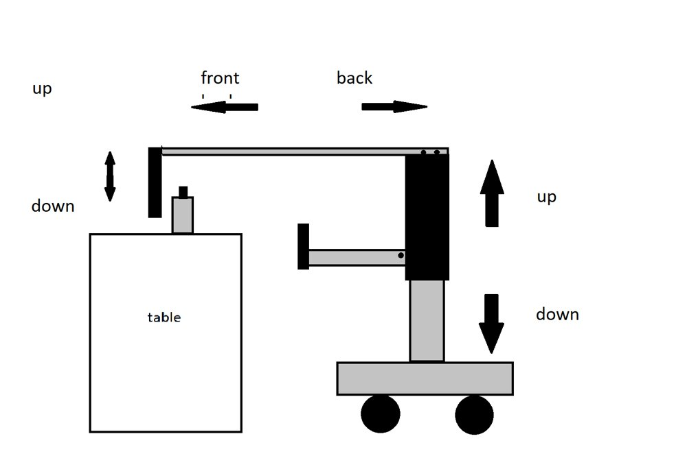
MODEL FRAMEWORK

Slide 6
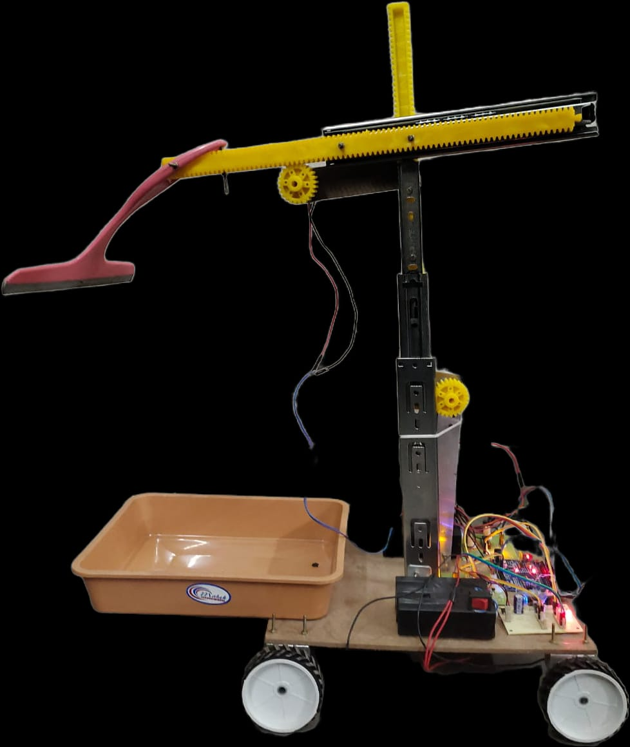
WORKING MODEL

Slide 7
WORKING
The lower hinge moves up and down to adjust the height to the required level.​
The upper hinge is used to drag the objects into the tray by moving to and fro.​
Tray collects the objects.​
The mobility of the device is based on external remote control. We can control the moment of hinges using the remote as well.​
At last we use the remote control to bring the objects to the user.​
We can control the moment of hinges using gears.

Slide 8
Conclusions
The model is helpful to the elderly and people with limited mobility.​
In conclusion, a robotic helper hand can be a valuable and transformative technology for individuals with limited mobility or strength in their hands and arms.​
Additionally, they can be customized to meet the specific needs of individual users and can be controlled using a variety of input devices, including joysticks, or buttons.

Slide 9
THANK YOU…

